Slide 1
Fisiologia Vegetal Nutrição vegetal
Segunda aula teórica de nutrição vegetal
2020-2021
Teresa Dias – mtdias@fc.ul.pt

Slide 2
Principais pontos da aula anterior
What defines an “essential” element?
In its absence the plant cannot complete a normal life cycle
Has a clear physiological role; the element is part of an essential molecule (macromolecule, metabolite) inside the plant
Beneficial nutrients are not essential!

Slide 4
I. Plant Nutrients – amount (Macro/Micronutrients)
Nutrient classifications
II. Plant Nutrients – mobility (mobile/immobile)
III. Plant Nutrients – function (4 groups)

Slide 5
Nutrient deficiency
Visual plant nutrient deficiency symptoms: are the expression of metabolic disorders resulting from insufficient supply of an essential nutrient.
Soil analysis: main disadvantage is the fact that there is a difference between total nutrients and available nutrients.
Plant tissue analysis: is done for N, P and K and for different crops, at different stages of the lifecycle and for different organs.

Slide 6
Nutrição Vegetal
Objectivos da 2ª aula: Como é feita a tomada de nutrients pelas plantas?
1 – Sistema radicular
2 – Tomada selectiva de nutrientes
3 – Tipos de transporte de nutrientes
4 – Factores que influenciam a tomada de nutrientes
Teresa Dias – mtdias@fc.ul.pt

Slide 7
How do plants acquire nutrients?
7

Slide 8
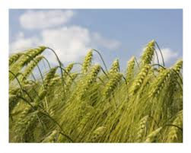
Root systems
The root system of a 16-week winter rye plant had
(Dittmer 1937):
13x10⁶ primary and lateral root axes
Extended for > 500 km in length
200 m² of surface area
10¹⁰ root hairs providing 300 m² of surface area
8

Slide 9
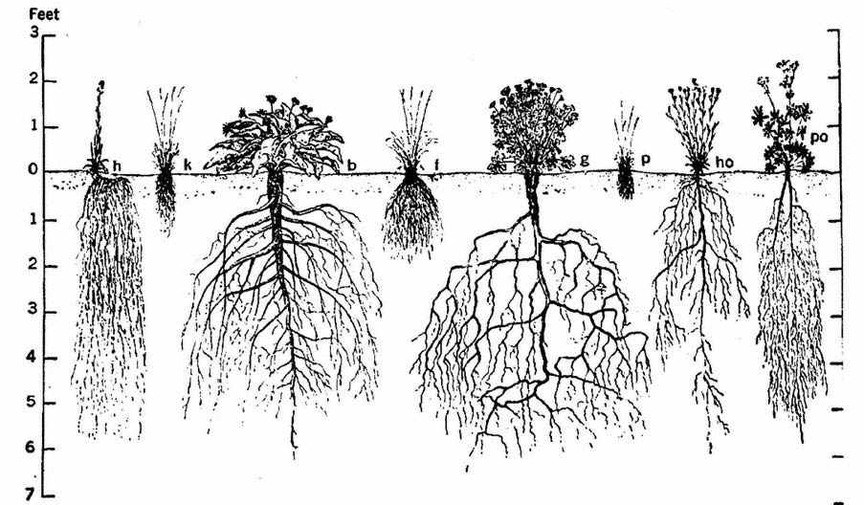
Diversity of root systems – reflects plant strategies and interactions with the environment
9

Slide 10
10

Slide 11
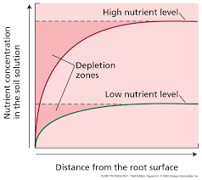
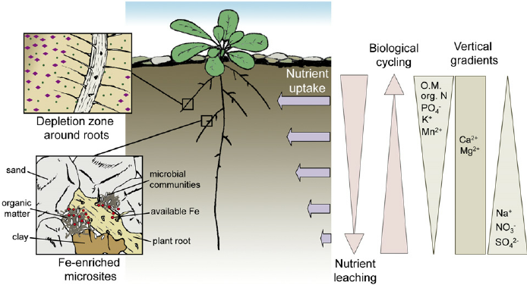
Nutrient depletion zones
11

Slide 12
How do plants overcome nutrient depletion zones?
Plant roots explore new soil patches (“alone” via root growth, and/or in association with mycorrhiza)
Nutrients can move to the root surface by:
Bulk flow (nutrients are carried by water moving through the soil toward the root); importance of soil moisture
Diffusion (mineral nutrients move from a region of higher concentration to a region of lower concentration)
Nutrient availability is dynamic; nutrients can be made available for plant uptake through:
Mineralization of organic matter
Solubilization of nutrients adsorbed to soil mineral particles
Mineral fertilization (in agriculture)
12

Slide 13
How do plants acquire nutrients?
13

Slide 14
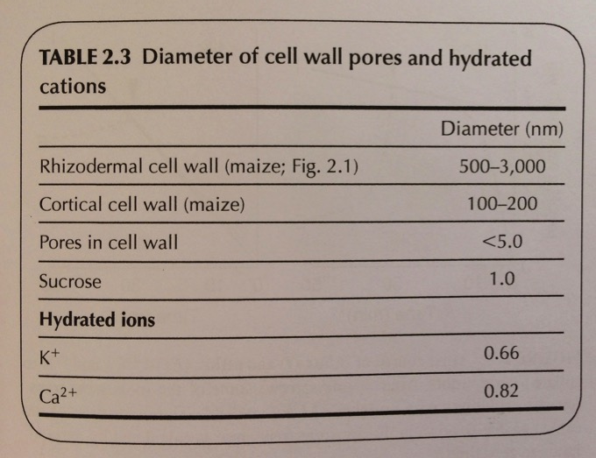
14

Slide 15
Transporte de nutrientes do solo para a raiz
O movimento dos nutrientes no apoplasto é passivo; ocorre dos locais mais concentrados para locais menos concentrados: difusão ou fluxo de massa
O tamanho máximo dos poros da parede celular é de 3,5-5,0 nm
MAS as paredes celulares podem interactuar com os solutos

Slide 16
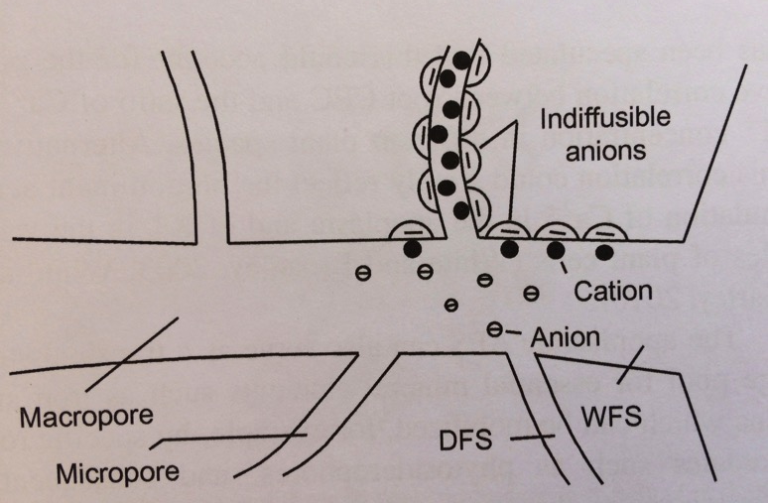
Transporte de nutrientes do solo para a raiz
Water Free Space (WFS): is that part of the space in which mobile cations and anions are in equal (equivalent) concentration, and corresponds to the extracellular space.
Donnan Free Space (DFS): is a homogeneous space containing indiffusible or restrained ions and to which the classical Donnan equations relating internal and external ionic activities can be applied.

Slide 17
Do apoplasto para o simplasto
O Cálcio sai facilmente da raíz para a solução, o potássio não
É provável que o Ca esteja no apoplasto
e o K no simplasto, ou sequestrado no vacúolo

Slide 18
Influxo, efluxo e fluxo

Slide 20
A membrana plasmática

Slide 21
Nernst equation

Slide 22
Nernst equation

Slide 23
Tipos de transporte

Slide 24
Transportadores

